Slide 1
Big Data Processing
Jiaul Paik
Lecture 9

Slide 2
Programming on Hadoop Map-reduce Model

Slide 3
MapReduce: Reduce Step
key-value pairs
(produced by Map step)
Output
key-value pairs
Key-value groups
k1
v1
reduce
k1
v1
v3
v6
k1
$$v′$$
k2
v2
Group
by key
reduce
k2
v2
v5
k2
$$v′′$$
k1
v3
…
k3
v4
…
…
k2
v5
k1
v6
k3
v4
reduce
k3
$$v′′′$$

Slide 4
Map-reduce: Word Count
Provided by the programmer
Handled by MR system
Provided by the programmer
MAP:
Read input and produces a set of key-value pairs
Group by key:
Collect all pairs with the same key
Reduce:
Collect all values belonging to the key and output
deep learning architectures such as deep neural networks, deep belief networks,
deep reinforcement learning, recurrent neural networks and
convolutional neural nets have been applied to fields including computer vision
(deep, 1)
(learning, 1)
(architectures, 1)
(such, 1)
(as, 1)
(…., 1)
(….., 1)
(…., 1)
(networks, 1)
(deep, 1)
(reinforcement , 1)
(…., 1)
(and, 1)
….
(vision, 1)
……..
(deep, 1)
(deep, 1)
(networks, 1)
(networks, 1)
(networks, 1)
(the, 1)
(the, 1)
(the, 1)
(reinforcement, 1)
(vision, 1)
…
(deep, 2)
(networks, 3)
(the, 3)
(reinforcement, 1)
(vision, 1)
…
Big document
(key, value)
(key, value)
(key, value)

Slide 5
Word Count Using MapReduce: Pseudocode
map(key, value)
// key: document name; value: text of the document
for each word w in value
emit(w, 1)
reduce(key, values)
// key: a word; value: set of counts values for a word
result = 0
for each count v in values:
result += v
emit(key, result)

Slide 6


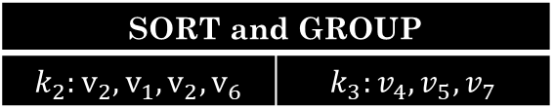
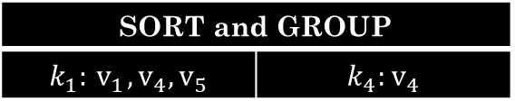

Map-reduce System: Inside Look
map task 1
map task 2
map task 3
data | data | data
data | data | data
data | data | data
M
M
M
M
M
M
M
M
M
($k_{1}, v_{1}$) ($k_{2}, v_{2}$) | ($k_{3}, v_{4}$) | ($k_{4}, v_{4}$)
($k_{2}, v_{1}$) | ($k_{1}, v_{4}$) ($k_{2}, v_{2}$) | ($k_{3}, v_{5}$)
($k_{2}, v_{6}$) | ($k_{3}, v_{7}$) | ($k_{1}, v_{5}$)
partition function
partition function
partition function
All phases are distributed with many tasks running in parallel
SORT and GROUP
$$k_{1}:{ v}_{1},v_{4},v_{5}$$ | $$k_{4}:v_{4}$$
SORT and GROUP
$$k_{2}:v_{2},v_{1},v_{2},v_{6}$$ | $$k_{3}:v_{4},v_{5},v_{7}$$
R
R
R
R
Final output | Final output
Final output | Final output
reduce task 1
reduce task 2

Slide 7
Shuffle and Sort: the map side
partition, sort and
spill to disk
map
merge on disk
Buffer in memory
on local disk
Input data
(chunk)
partitions

Slide 8
Shuffle and Sort: the reduce side
map
merge
reduce
merge
output
map
merge
map
reduce
output
map
reduce
output
map phase

Slide 9
Map-Reduce Internals Additional Details

Slide 10
What Map-Reduce Framework Does for You?
Partitioning the input data
Scheduling the program`s execution across a set of machines
Performing the group by key step
Handling machine failures
Inter-machine communication

Slide 11
Data Flow
Input and final output are stored on a distributed file system
Scheduler tries to schedule map tasks “close” to storage location of input data
This minimizes data movement through the network
Intermediate results are stored on local file system of Map and Reduce workers
Output can be input to another Map-reduce task

Slide 12
Coordination by Master
Master node takes care of coordination:
Task status: (idle, in-progress, completed)
Idle tasks get scheduled as workers become available
When a map task completes, it records the location and sizes of the intermediate files
Master pings periodically to detect failures

Slide 13
Dealing with Failures
Map worker failure
Map tasks completed or in-progress at worker are reset to idle
Why?
Reduce workers are notified when task is rescheduled on another worker

Slide 14
Dealing with Failures
Reduce worker failure
Only in-progress tasks are reset to idle
Why?
Reduce task is restarted

Slide 15
Dealing with Failures
Master failure
Map-reduce task is aborted and client is notified

Slide 16
How many Map and Reduce jobs?
$M$map tasks, $R$reduce tasks
General Rule:
Make $M$ much larger than the number of nodes in the cluster
One DFS chunk per map is common
Improves dynamic load balancing
Speeds up recovery from worker failures
Usually $R$ is smaller than $M$

Slide 17
Map-Reduce Algorithm Design

Slide 18
Problems Suitable for Map-reduce
Map-reduce is suitable for batch processing
Updates are made after whole batch of data is processed
The mappers and reducers do not need large volume of data from one another while they are running
In general, map-reduce is suitable:
When the problem can be broken into independent components

Slide 19
Problems NOT Suitable for Map-reduce
Large shared data with frequent updates
Online algorithms
Quick response time
In milliseconds

Slide 20
Map-Reduce Algorithm Template
Main Components
Mapper
Reducer
Optional Components (need based and for optimized execution)
Combiner
Partitioner

Slide 21
Mapreduce Types
map function
K1 -> input key
V1 -> input value
K2 -> output key
V2 -> output value
map: (K1, V1) → list(K2, V2)

Slide 22
Mapreduce Types
reduce function
K2 -> input key
list(V2) -> list of values associated with a key K2
K3 -> output key
V3 -> output value
reduce: (K2, list(V2)) → list(K3, V3)

Slide 23
Problems

Slide 24
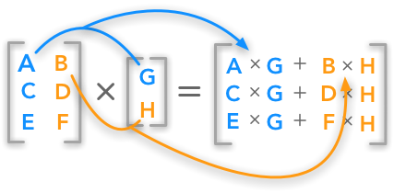
Matrix Vector Product: Map-reduce Algorithm

